Slide 1

MALIGNANT COMMENT CLASSIFICATION

Slide 2
INTRODUCTION
People use social media as a platform to express their opinions and views.
They do this freely and without any reluctance.
With it comes the risk of cyber abuse and harassment, which can put an end to people expressing themselves and giving up on seeking opinions.
To protect the users from cyberbullying, every organization should have an automated system in place to identify such malicious comments and suitable actions against the same.

Slide 3

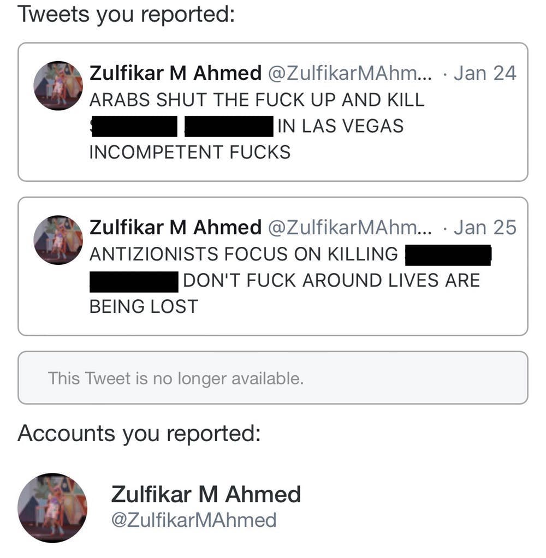
OBJECTIVE
We have undertaken this project to classify the comments made by different users on social media platforms, to build a model that is capable of detecting and classifying these comments into various classes like threat, abuse, loathe and rude.

Slide 4

PREPROCESSING OF THE DATA
We have performed the following preprocessing on the data:
Removed punctuations
Removed the stop words
Stemming and lemmatization
Applied counter vectorizer

Slide 5
DATA MODELLING
Problem Transformation Method
We used the Multinomial Naïve Bayes classifier for classification.
We used this classifier, since it is suitable for classification with discrete features.

Slide 6
DATA VISUALIZATIONS

Slide 7
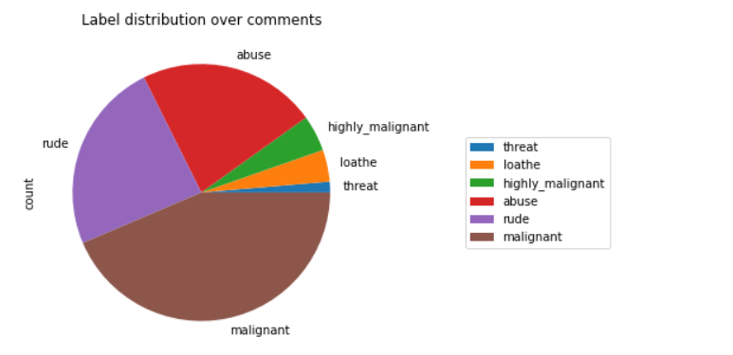
DATA VISUALIZATIONS

Slide 8

ANALYSIS OF RESULTS
Upon testing the models, on the malignant comments we have analyzed the following:
Most of the tweets are up to 200 characters long.

Slide 9
CHALLENGES
Multiple labels – For Binary classification we have many models available but for multilabel classification the selection of models decreases drastically.
Collection of USABLE DATA – although we extracted over 100000 records, only 14000 records were usable among them.
Cleaning the data – Due to the character limit tweets contain a lot of short forms which are different to classify using bag of words model.

Slide 10
THANK YOU

